Slide 1
UNIT V Trends in Software Engineering

Slide 2
Agile Management and Practices
Agile Practices: Agile manifesto, The Fundamentals of Agile Software Development, Aspects of Agile Approaches, Practices and Processes, Techniques in Agile Projects, Extreme Programming, Devops: Introduction-Definition, Devops Tool chain, Why Devops?, Goals, Benefits, Relationship to Agile and Devops (continuous delivery), Devop Tools. Role of Software engineering in IoT applications, data science applications, cloud computing and cyber security applications.

Slide 3
Agile Software Development
Agile software development is a methodology that refers to a group of software development methodologies based on iterative development, where requirements and solutions evolve through collaboration between self-organizing cross-functional teams.
It helps teams provide quick and unpredictable responses to the feedback they receive on their project.
It creates opportunities to assess a project’s direction during the development cycle. Teams assess the project in regular meetings called sprints or iterations.

Slide 4
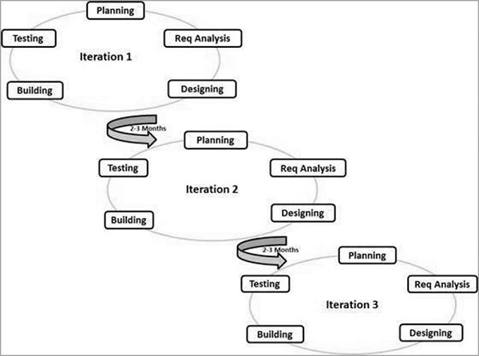
Agile SDLC Model
Agile is both incremental and iterative. They are iterative in that they plan for the work of one iteration to be improved upon in subsequent iterations.
They are incremental because completed work is delivered throughout the project.

Slide 5
Waterfall vrs Agile
Waterfall is a structured software development methodology so most times it can be quite rigid. ... Software development will be completed as one single project.
Agile is quite a flexible method which allows changes to be made in the project development requirements even if the initial planning has been completed.

Slide 6
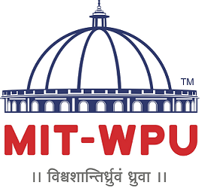
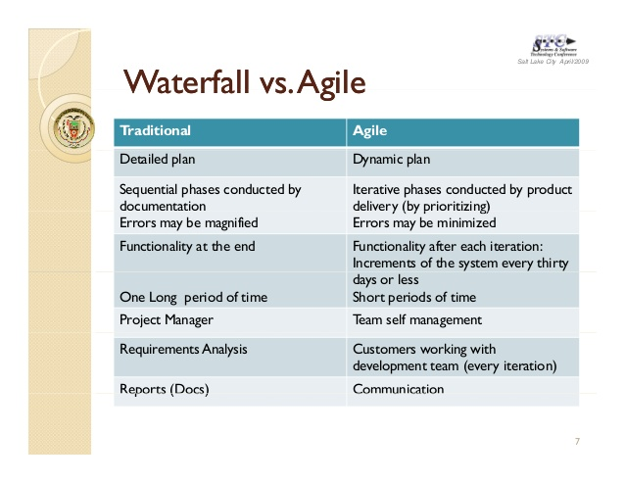
Traditional Process model vs Agile

Slide 7
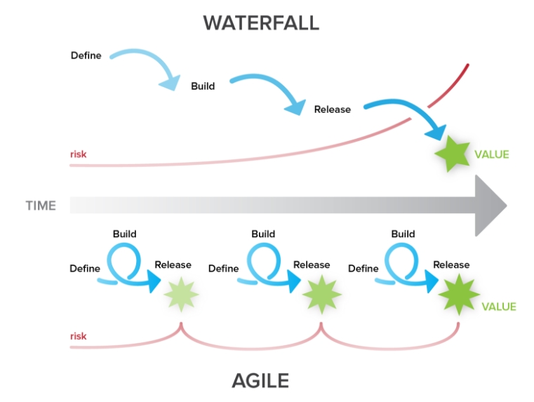
Waterfall model vs Agile

Slide 8
Plan-driven and agile development
Plan-driven development
A plan-driven approach to software engineering is based around separate development stages with the outputs to be produced at each of these stages planned in advance.
Not necessarily waterfall model – plan-driven, incremental development is possible
Iteration occurs within activities.
Agile development
Specification, design, implementation and testing are inter-leaved and the outputs from the development process are decided through a process of negotiation during the software development process.

Slide 9
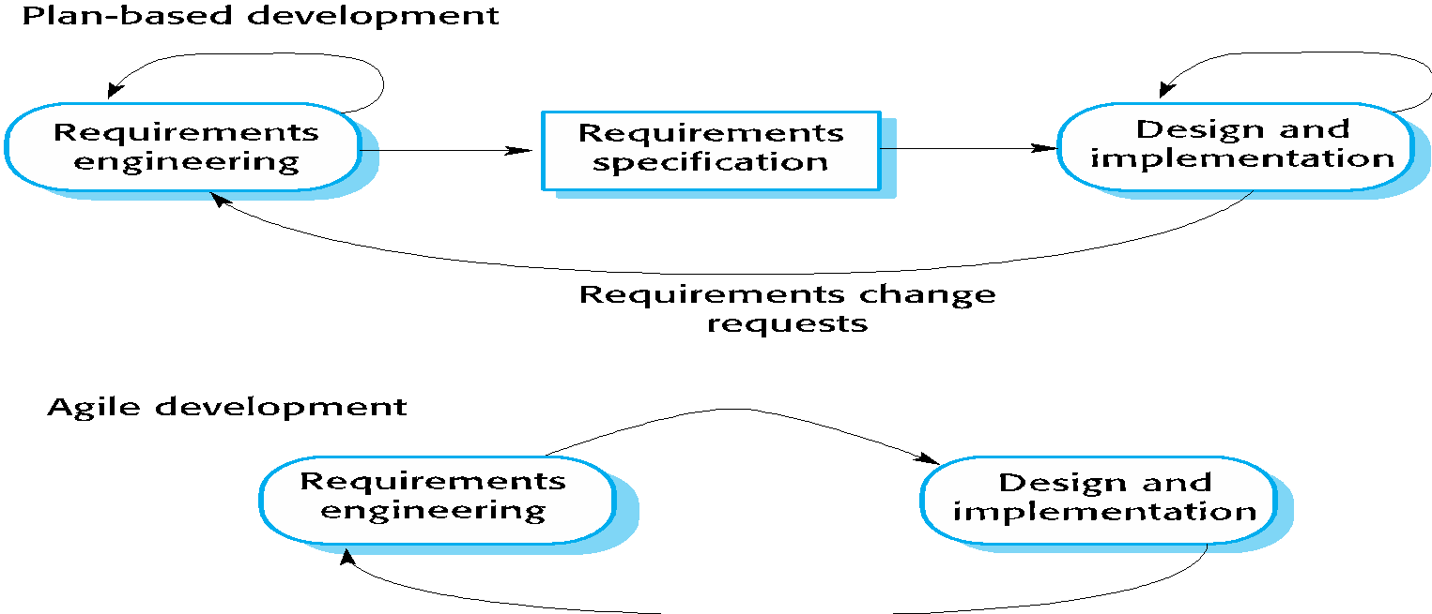
Plan-driven and agile specification

Slide 10
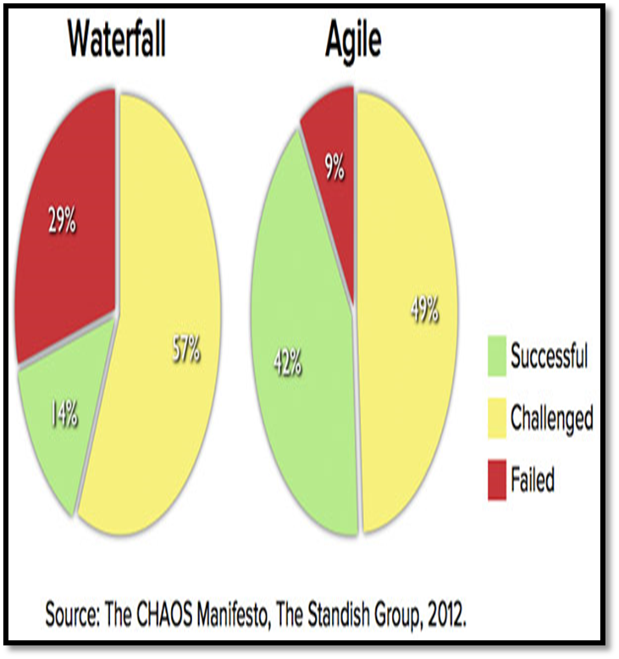
Comparison of failure rate

Slide 11
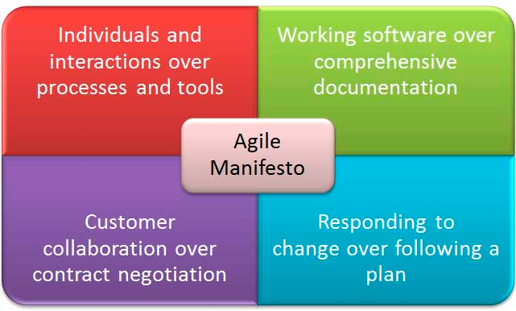
Agile Manifesto
The four core values of Agile software development as stated by the Agile Manifesto are:

Slide 12

Individuals and Interactions over Processes and Tools
People make biggest impact on success
Process and environment help, but will not create success.
Strong individuals not enough without good team interaction.
Individuals may be stronger based on their ability to work on a team.
Tools can help, but bigger and better tools can hinder more than help
Simpler tools can be better

Slide 13
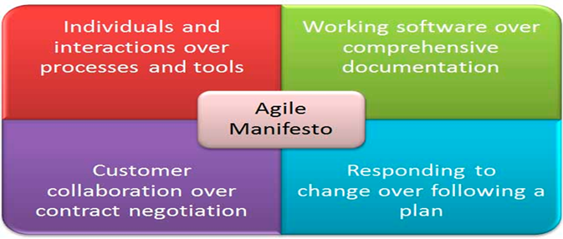
Working Software over Comprehensive Documentation
Documentation important, but too much is worse than too little
Long time to produce, keep in sync with code
Keep documents short and salient
Focus effort on producing code, not descriptions of it
Code should document itself
Knowledge of code kept within the team
Produce no document unless its need is immediate and significant.

Slide 14
Responding to Change over Following a Plan
Agile Development is focused on quick responses to change and continuous development.
Changes due to Environment, requirements, and estimates of work are inevitable.
Planning out a whole project doesn’t hold up
Changes in shape, not just in time
Keep planning realistic
Know tasks for next couple of weeks
Rough idea of requirements to work on next few months
Vague sense of what needs to be done over year

Slide 15
Customer Collaboration over Contract Negotiation
As the requirements cannot be gathered completely in the beginning of the project due to various factors, continuous customer interaction is very important to get proper product requirements.
Get regular customer feedback

Slide 16
Agile method is suitable if …
Product development where a software company is developing a small or medium-sized product for sale.
Customized system development within an organization, where there is a clear commitment from the customer to become involved in the development process and where there are not a lot of external rules and regulations that affect the software.
Because of their focus on small, tightly-integrated teams, there are problems in scaling agile methods to large systems.

Slide 17
Principles in Agile Projects
1. Our highest priority is to satisfy the customer through early and continuous delivery of valuable software.
2. Welcome changing requirements, even late in development. Agile processes harness change for the customer's competitive advantage.
3. Deliver working software frequently, from a couple of weeks to a couple of months, with a preference to the shorter timescale.
4. Business people and developers must work together daily throughout the project.
5. Build projects around motivated individuals. Give them the environment and support they need, and trust them to get the job done.
6. The most efficient and effective method of conveying information to and within a development team is face–to–face conversation.

Slide 18
Principles in Agile Projects
Working software is the primary measure of progress.
Agile processes promote sustainable development. The sponsors, developers, and users should be able to maintain a constant pace indefinitely.
Continuous attention to technical excellence and good design enhances agility.
Simplicity – the art of maximizing the amount of work not done – is essential.
The best architectures, requirements, and designs emerge from self–organizing teams.
At regular intervals, the team reflects on how to become more effective, then tunes and adjusts its behavior accordingly.

Slide 19
Purpose of Agile Manifesto and Principles
Proponents of Agile methodologies say the four values outlined in the Agile Manifesto promote a software development process that focuses on quality by creating products that meet consumers' needs and expectations.
The 12 principles are intended to create and support a work environment that is focused on the customer, that aligns to business objectives, and that can respond and pivot quickly as user needs and market forces change

Slide 20
Agile methods and software maintenance
Most organizations spend more on maintaining existing software than they do on new software development. So, if agile methods are to be successful, they have to support maintenance as well as original development.
Two key issues:
Are systems that are developed using an agile approach maintainable, given the emphasis in the development process of minimizing formal documentation?
Can agile methods be used effectively for evolving a system in response to customer change requests?
Problems may arise if original development team cannot be maintained.

Slide 21
An Agile Practices and Processes
Is driven by customer descriptions of what is required (scenarios). Some assumptions:
Recognizes that plans are short-lived (some requirements will persist, some will change. Customer priorities will change)
Develops software iteratively with a heavy emphasis on construction activities (design and construction are interleaved, Design models are proven as they are created. )
Analysis, design, construction and testing are not predictable.
Thus has to Adapt as changes occur due to unpredictability
Delivers multiple ‘software increments’, deliver an operational prototype or portion of an OS to collect customer feedback for adaption.

Slide 22
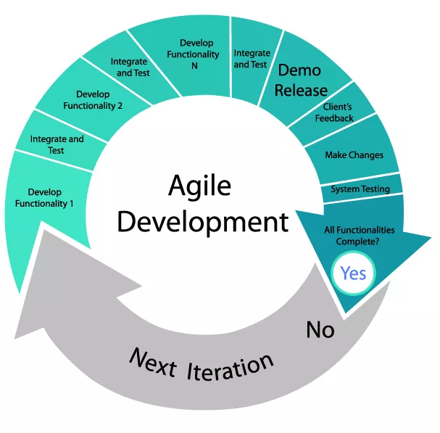
Agile Software Development Processes

Slide 23
Agile Software Development Processes
Agile software development is a conceptual framework for software engineering that promotes development iterations throughout the life-cycle of the project.
Software developed during one unit of time is referred to as an iteration, which may last from one to four weeks.
Agile methods also emphasize working software as the primary measure of progress

Slide 24
Agile Software Development Processes
Characteristics of Agile Software Development
Light Weighted methodology
Small to medium sized teams
Vague and/or changing requirements
Vague and/or changing techniques
Simple design
Minimal system into production

Slide 25
Aspects of Agile Approaches
Collaborative User Story creation
Retrospective
Continuous Integration
Iteration and release planning

Slide 26
Collaborative User Story creation
User Stories adhere to a specific, predefined structure, and are thus a simplistic way of documenting the requirements, and desired end-user functionality.
A User Story tells you three things about the requirement; Who, What, and Why.
The requirements expressed in User Stories are short, simple, and easy-to-understand statements.

Slide 27
Format for creation of User Story
A useful format for creating a User Story is the following: "As a <role>, I want <goal/ desire> so that <benefit>". Here is an example using the format: As a Database Administrator, I should be able to revert a selected number of database updates so that the desired version of the database is restored.

Slide 28
Retrospectives
The Retrospect Sprint Meeting is an important element of the ‘inspect-adapt’ Scrum framework and it is the final step in a Sprint.
Some facts and some techniques are as follows:
Meet at the end of each iteration
What worked and what didn’t work so well
How to improve and how to retain success
Discussed on process, people, organizations, relationships, tools.
Follow through is required.
Essential to self-organization and continual improvement
Address on: test effectiveness/ efficiency, test case quality, team satisfaction, and testability issues.

Slide 29
Continuous Integration
This software engineering practice used for merging all developer working copies with a shared mainline multiple times a day. Some key points:
Following steps are follows in integration process:
Merge changes and integrate all code daily (or more often) for quick discovery of defects
Developers code, debug, and check-in
Continuous Integration automatically:
Static code analysis
Compile
Unit test (functional/ non-functional)
Deploy
Integration test (functional/ non-functional)
Report
Automated Continuous Integration, regression testing, and feedback
Manual testing of new features, changes, and defect fixes
Some defects are put in the product backlog

Slide 30
Iteration and release planning
Iteration and release planning sessions are conducted to develop a Release Plan.
The plan defines when various sets of usable functionality or products will be delivered to the Customer.
The major objective of Team to have an overview of the releases and delivery schedule for the product they are developing, so that they can align with the expectations of the Product Owner and relevant Stakeholders (primarily the project sponsor).

Slide 31
Release Planning
Planning is an on-going activity
For Agile lifecycles: release and iteration planning
Release planning
Define product backlog (User Stories for release)
Refine user epics
Basis of test approach and test plan for release
Identify project/ quality risks, estimate effort
Testers:
Define testable User Stories
Participate in project and quality risk analyses
Estimate test effort
Plan testing for release
Release plans may change during project due to internal and external factors
Testers must handle changes, see larger context of release, and obtain an adequate test basis and test oracles

Slide 32
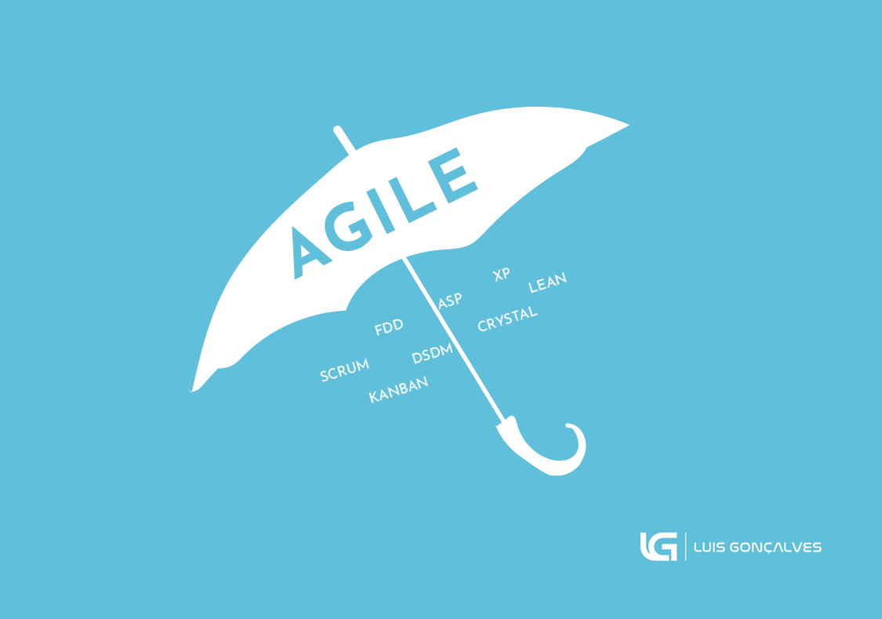
Agile Methodology / Process Models
There are several agile methodologies; all share similar philosophies, characteristics, and practices.
However, from the point of implementation each agile has its own practices, terminology, and tactics.
Some of the main agile software development methodology components include:

Slide 33
Agile Methodology/ Process Models
Extreme Programming XP
Scrum
Dynamic Systems Development Method (DSDM)
Agile Modeling
Agile Unified Process

Slide 34
1. Extreme programming
One of the most well-known agile methods
Extreme Programming (XP) takes an ‘extreme’ approach to iterative development.
New versions may be built several times per day;
Increments are delivered to customers every 2 weeks;
All tests must be run for every build and the build is only accepted if tests run successfully.

Slide 35
XP is appropriate where
The general characteristics where XP is appropriate were :
Dynamically changing software requirements
Risks caused by fixed time projects using new technology
Small, co-located extended development team
The technology you are using allows for automated unit and functional tests

Slide 36
5 values of XP are
Communication : to transfer knowledge from one team member to everyone else on the team.
Simplicity : Simplicity means “what is the simplest thing that will work?” This helps to avoid waste and do only absolutely necessary things
Feedback : Through constant feedback, teams can identify areas for improvement and revise their practices.
Courage: You need courage to raise organizational issues , to stop doing something that doesn’t work , and need courage to accept and act on feedback, even when it’s difficult to accept.
Respect : The members of your team need to respect each other in order to communicate with each other and to work together to identify simple designs and solutions.

Slide 37
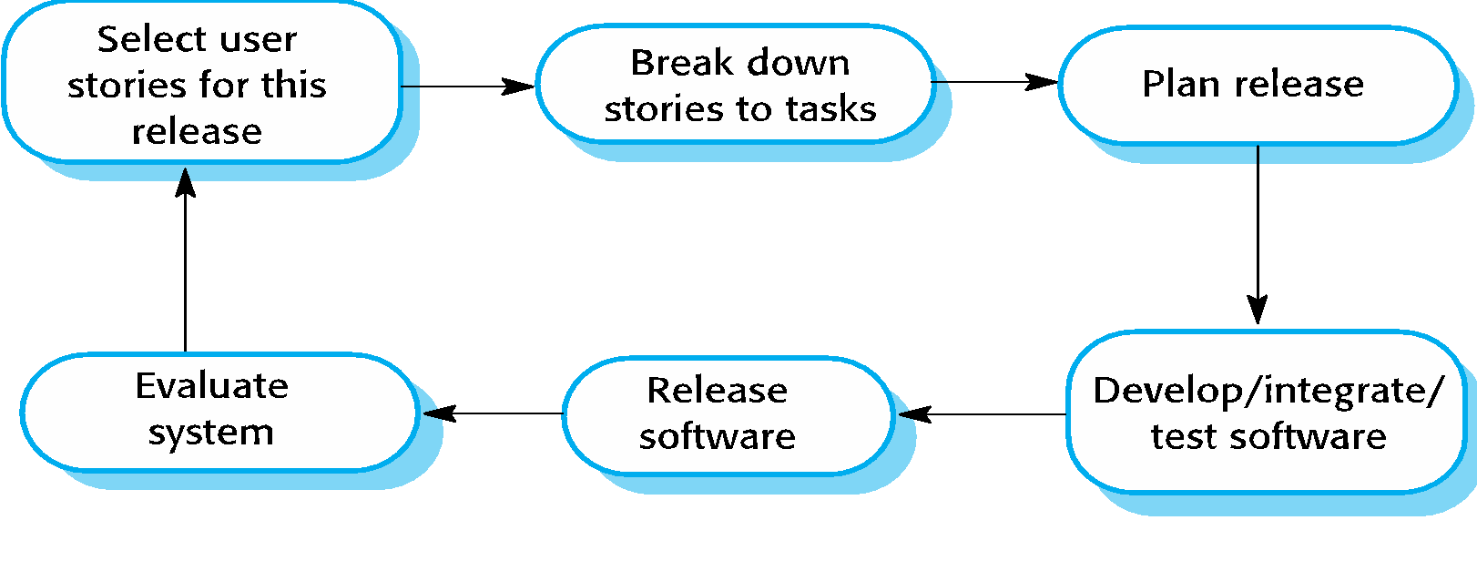
The extreme programming release cycle
A user story is an informal, natural language description of one or more features of a software system. User stories are often written from the perspective of an end user or user of a system

Slide 38
Extreme programming practices (a)
Principle or practice | Description
Incremental planning | Recorded stories on story cards and their relative priority. The developers break these stories into development ‘Tasks’.
Small releases | Set of functionality that provides business value is developed first. Releases of the system are frequent and incrementally add functionality to the first release.
Simple design | Enough design is carried out to meet the current requirements and no more.
Test-first development | An automated unit test framework is used to write tests for a new piece of functionality before that functionality itself is implemented.
Refactoring | All developers are expected to refactor the code continuously as soon as possible code improvements are found. This keeps the code simple and maintainable.

Slide 39
Extreme programming practices (b)
Pair programming | Developers work in pairs, checking each other’s work and providing the support to always do a good job.
Collective ownership | The pairs of developers work on all areas of the system, and all the developers take responsibility for all of the code. Anyone can change anything.
Continuous integration | As soon as the work on a task is complete, it is integrated into the whole system. After any such integration, all the unit tests in the system must pass.
Sustainable pace | Large amounts of overtime are not considered acceptable as the net effect is often to reduce code quality and medium term productivity
On-site customer | A representative of the end-user of the system (the customer) should be available full time for the use of the XP team. In an extreme programming process, the customer is a member of the development team and is responsible for bringing system requirements to the team for implementation.

Slide 40
2. SCRUM
Scrum is an Agile Software Development Process.
Scrum is not an acronym
Name taken from the sport of Rugby, where everyone in the team pack acts together to move the ball down the field
Analogy to development is the team works together to successfully develop quality software.
Scrum focuses on the entire organization for its implementation to be a success.

Slide 41
SCRUM
Scrum principles include:
Quality work: empowers everyone involved to be feel good about their job.
Assume Simplicity: Scrum is a way to detect and cause removal of anything that gets in the way of development.
Embracing Change: Team based approach to development where requirements are rapidly changing.
Incremental changes: Scrum makes this possible using sprints where a team is able to deliver a product (iteration) deliverable within 30 days.

Slide 42
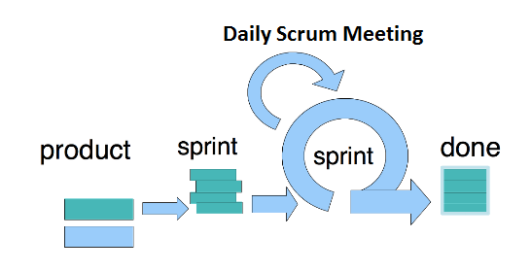
Sprints in SCRUM
A sprint is a short, time-boxed period when a scrum team works to complete a set amount of work. Sprints are the very heart of scrum and agile methodologies.
With Scrum, a product is built in a series of iterations called sprints that break down big, complex projects into bite-sized pieces.
The goal of this meeting is to surface any
blockers and challenges that would impact
the teams ability to deliver the sprint goal.

Slide 43
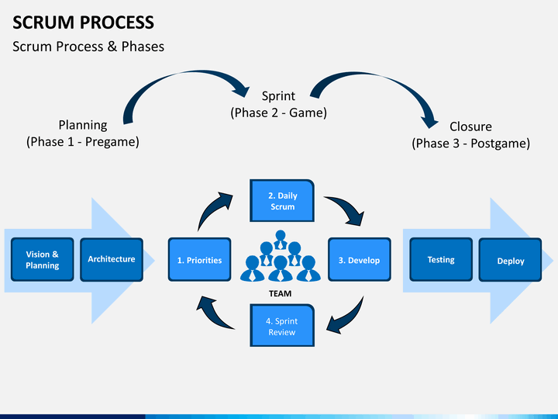
Scrum Methodology- Scrum Phases

Slide 44
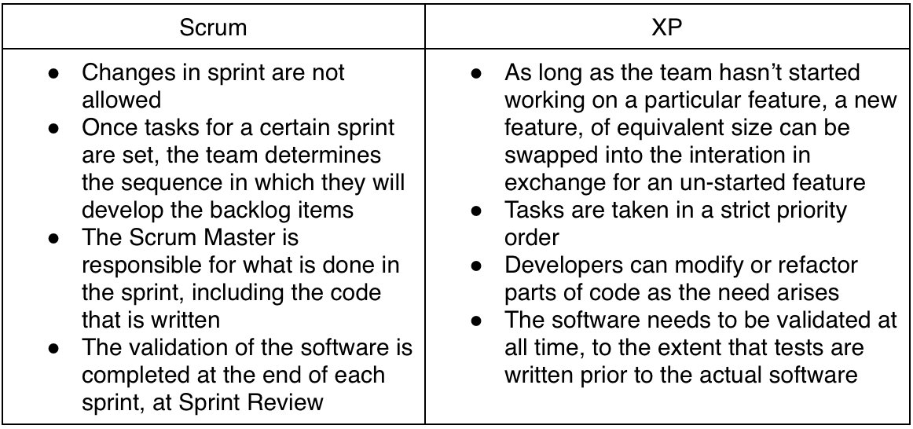
Difference Between Scrum vs XP

Slide 45
3. Dynamic System Development Method (DSDM)
It is an iterative, incremental approach that is largely based on the RAD
The method provides a four-phase framework consisting of:
Feasibility and business study
Functional model / prototype iteration
Design and build iteration
Implementation
Eliminate problems of:
Going over-budget
Missing deadlines
Users not involved
Management not committed

Slide 46
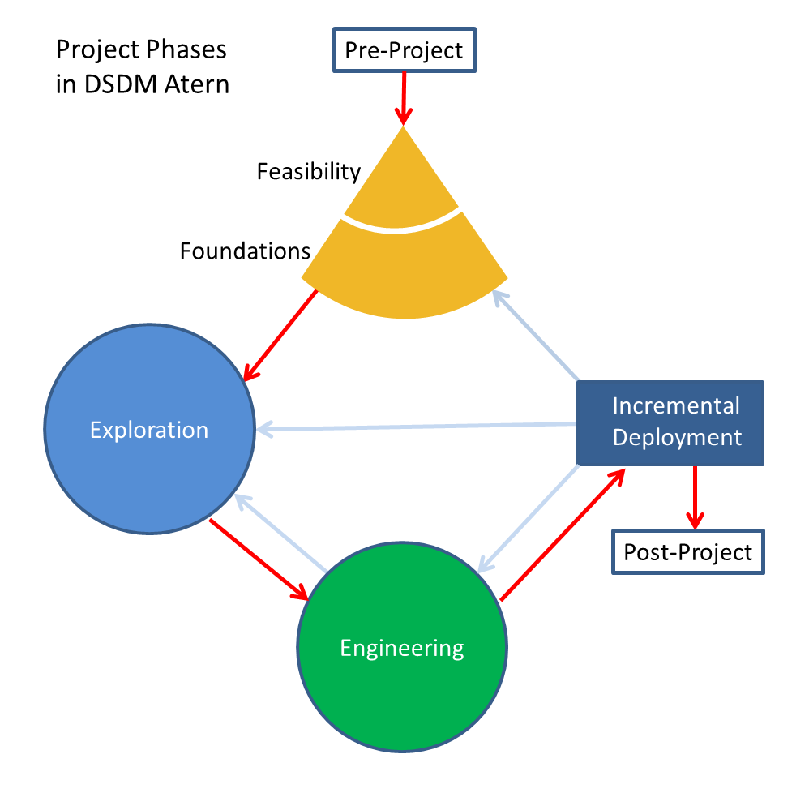
DSDM Development Process
Function Modeling
Design and Build Iteration

Slide 47
DSDM 9 Principles
1. Active user involvement
2. Teams must be empowered to make their own decisions.
3. Frequent releases more important than maximizing quality.
4. Primary criteria for deliverables is meeting business needs.
5. Iterative development is essential to reach correct solution.
6. Any change during development can be reversed.
7. The most high level requirements should be unchangeable.
8. Testing shall occur throughout the lifecycle of the project.
9. All stakeholders must cooperate and communicate.

Slide 48
4. Feature Driven Development FDD
FDD organizes software development around making progress on features.
A feature is a small, client-valued function expressed in the form <action><result><object>.
That project lifecycle looks like this:
Develop an overall model
Build a features list
Plan by feature
Design by feature
Build by feature

Slide 49
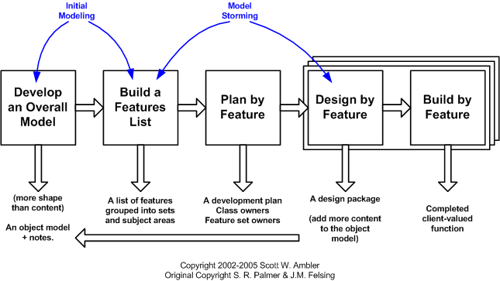
FDD Lifecycle

Slide 50
FDD – Website development
Feature Driven Development stresses in creating shorter iterations of functionality, with each functionality catering to certain features in the website.
Best suitable as functionality of complex web-projects grows up

Slide 51
Strengths and Weaknesses
FDD’s strengths include:
Simple five-step process allows for more rapid development
Allows larger teams to move products forward with continuous success
Leverages pre-defined development standards, so teams are able to move quickly
FDD’s weaknesses include:
Does not work efficiently for smaller projects
Less written documentation, which can lead to confusion
Highly dependent on lead developers or programmers

Slide 52
5. Agile Unified Process (AUP)
AUP describes a simple, easy to understand approach to developing application using agile techniques and concepts yet still remaining true to the RUP.
AUP has 7 phases :
Model.
Implementation.
Test.
Deployment.
Configuration Management.
Project Management.
Environment.

Slide 53
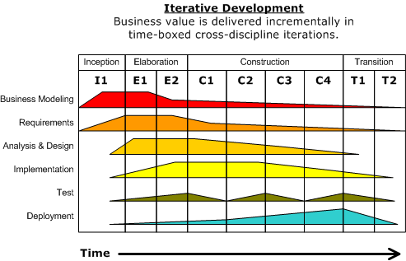
RUP (Revision)
The unified process model is an iterative, incremental and use-case driven approach for developing software.
It consists of four phases viz. inception, elaboration, construction and transition. This process treats software development as a 'unification' of mini iterations.

Slide 54
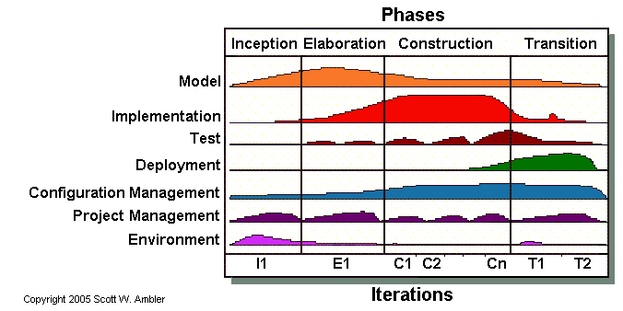
AUP

Slide 55
AUP : serial nature
The serial nature of Agile UP is captured in its four phases :
Inception. The goal is to identify the initial scope of the project, a potential architecture for your system, and to obtain initial project funding and stakeholder acceptance.
Elaboration. The goal is to prove the architecture of the system.
Construction. The goal is to build working software on a regular, incremental basis which meets the highest-priority needs of your project stakeholders.
Transition. The goal is to validate and deploy your system into your production environment.

Slide 56
Iterative in AUP
The disciplines are:
Model. understand the business of the organization, the problem domain being addressed by the project, and to identify a viable solution to address the problem domain.
Implementation. : transform your model(s) into executable code and to perform a basic level of testing, in particular unit testing.
Test. : perform an objective evaluation to ensure quality. This includes finding defects, validating that the system works as designed, and verifying that the requirements are met.
Deployment. The goal of this discipline is to plan for the delivery of the system and to execute the plan to make the system available to end users.
Configuration Management. The goal of this discipline is to manage access to your project artifacts. This includes not only tracking artifact versions over time but also controlling and managing changes to them.
Project Management. The goal of this discipline is to direct the activities that takes place on the project. This includes managing risks, and coordinating with people and systems to be sure that it is delivered on time and within budget.
Environment. The goal of this discipline is to support the rest of the effort by ensuring that the proper process, guidance (standards and guidelines), and tools (hardware, software, etc.) are available for the team as needed.

Slide 57
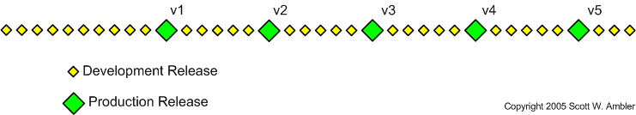
Delivering Incremental Releases Over Time
Instead of the "big bang" approach where you deliver software all at once you instead release it into production in portions (e.g. version 1, then version 2, and so on).

Slide 58
Agile Unified Process Goals
Stakeholders focus on the problem, solution, and constraints (visioning workshops).
Users focus on their needs and product features at a high level (requirements workshops).
The stakeholders and users focus on establishing the business justification for the product and project.
The users and software development team focus on establishing the technology justification for the product and project.
The team (software development team, stakeholders, and users) focus on prioritizing risks and opportunities (road-mapping workshops).
The team focuses on relating product features to Execute (Innovation) goals and objectives in the project roadmap (road-mapping workshops).
The team establishes the development infrastructure.

Slide 59
Agile Recommendations
If you are a lone programmer, use the XP practices that are suitable for you.
If you are a small team (two to eight people), consider using XP and introducing XP practices in small bunches, each bunch every two to three weeks.
If you are in charge of a bigger team (eight to 20), consider using Scrum or Crystal as a high-level process "container," together with the XP practices that you deem sensible to use in your project.
If you don't want to give up what you were taught (and maybe you are doing well) about OO modeling or code ownership, consider FDD, regardless of the size of your team.
If the team is even bigger than 20 people, again consider Scrum, Crystal, or FDD, depending on your needs and preferences.

Slide 60
Benefits of Using Agile
Is a very realistic approach to software development.
Promotes teamwork and cross training.
Functionality can be developed rapidly and demonstrated.
Resource requirements are minimum.
Suitable for fixed or changing requirements
Delivers early partial working solutions.
Good model for environments that change steadily.
Minimal rules, documentation easily employed.
Enables concurrent development and delivery within an overall planned context.
Little or no planning required.
Easy to manage.
Gives flexibility to developers.

Slide 61
Problems with agile methods
Not suitable for handling complex dependencies.
More risk of sustainability, maintainability and extensibility.
An overall plan, an agile leader and agile PM practice is a must without which it will not work.
Strict delivery management dictates the scope, functionality to be delivered, and adjustments to meet the deadlines.
Depends heavily on customer interaction, so if customer is not clear, team can be driven in the wrong direction.
There is a very high individual dependency, since there is minimum documentation generated.
Transfer of technology to new team members may be quite challenging due to lack of documentation.

Slide 62
Popular Agile Tools
ActiveCollab. An affordable tool for small businesses, ActiveCollab is easy to use. This software development aid requires little training and provides excellent support.
Agilo for Scrum. Stakeholders get updated automatically on the project’s progress with Agilo for Scrum. Features sprint reports and burn down charts for better data mining.
Atlassian Jira + Agile. This powerful project management tool facilitates development by incorporating Scrum, Kanban, and customizable workflows.

Slide 63
Summary
Agile models are based on iterative software development.
An independent working module is built after the completion of iteration. Iteration should not consume more than two weeks to complete a code. Agile methodologies invite the developers to get involved in testing, rather than a separate quality assurance team.
Agile methodologies are suitable in changing environments because of new practices and principles that enable a team to develop a product in short duration.

Slide 64
DevOps

Slide 65
DevOps
Introduction-Definition
Why DevOps ,Goals, Benefits
DevOps Tool chain
Relationship to Agile and DevOps (continuous delivery)
DevOp Tools.

Slide 66
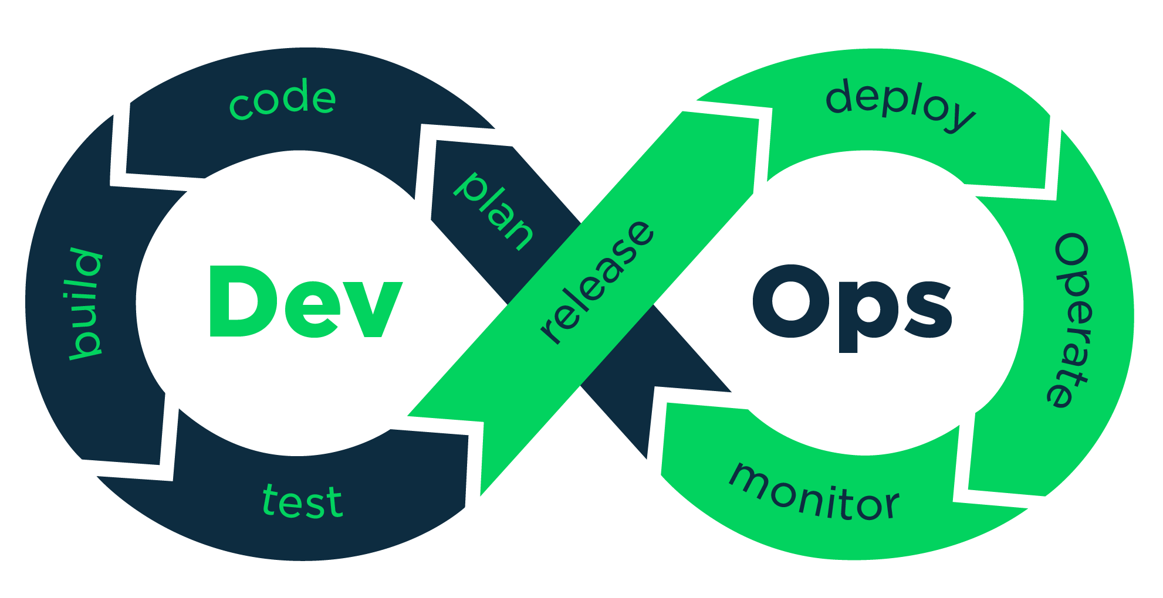
DevOps
The term DevOps was introduced in 2007-2009 by Patrick Debois, Gene Kim, and John Willis
DevOps represents the combination of Software Development (Dev) and IT Operations (Ops) in alignment with Software Engineering processes.
DevOps is an umbrella term that describes the operation of a Software Development team collaborating through the development stages.
DevOps promotes collaboration between Development and Operations team to deploy code to production faster in an automated & repeatable way.
The DevOps is a set of practices designed to overcome the gap between development, QA and Operations by effective communication and collaboration

Slide 67
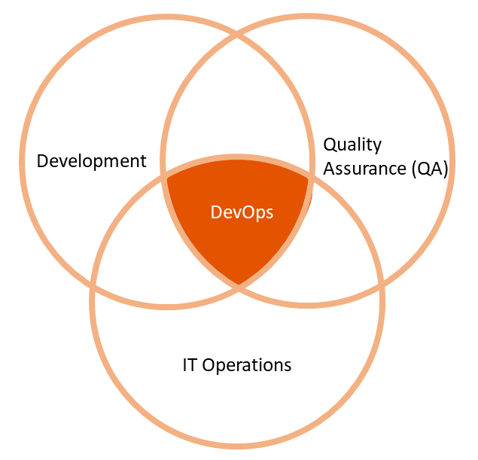
DevOps
DevOps is a combination of tools and philosophies that increase a team’s capability to produce results at high efficiency.
DevOps is often associated with software engineering practices
Continuous Integration (CI)
Continuous Delivery (CD)
Infrastructure as Code (IaC)
DevOps helps to increase an organization’s speed to deliver applications and services.
DevOps allows organizations to serve their customers better and compete more strongly in the market
DevOps represents a change in the IT culture with a complete focus on rapid IT service delivery through the adoption of agile practices in the context of a system-oriented approach.
Agile development is one significant part of DevOps and as a significant influence in its creation.

Slide 68
Why DevOps?
Software development teams who adopt a DevOps approach tend to finish their projects faster.
DevOps ensures fewer miscommunications. It helps teams to add-on improvements and other needed changes quickly.
The DevOps approach encourages more collaboration between the operations and development teams, and everyone’s objectives are more aligned.
DevOps helps adapting to changing requirements in the agile methodology in seamless manner. Hence it responds faster to the market changes to improve business growth.
DevOps is an excellent approach for quick development and deployment of applications. Thus DevOps increases business profit by decreasing software delivery time and transportation costs.
DevOps clears the descriptive process, which gives clarity on product development and delivery. As a result it improves customer experience and satisfaction.
DevOps simplifies collaboration and places all tools in the cloud for customers to access.
DevOps means collective responsibility, which leads to better team engagement and productivity.
By not using a DevOps approach, teams may find that projects end up late more often, and they are just not as efficient overall.

Slide 69
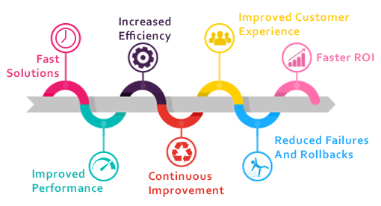
Benefits of using DevOps

Slide 70
DevOps Goals
DevOps can help ensure that your applications are delivered on time and with high quality
It can also help reduce the number of errors and defects in your code.
Improved Quality
With DevOps one can deploy new features faster and more efficiently.
It helps to release new versions of your applications more frequently, leading to a higher level of customer satisfaction.
Faster Development Processes
DevOps quickly respond to changes in the market or regulatory environment.
This enables to stay ahead of the competition and maintain a leadership position in your field.
Increased Agility
Operators can take over specific tasks or processes previously handled by developers, leading to a decrease in the number of errors and increased efficiency.
Reduced risk
When developers and operators work together closely, they can identify problems early on and make necessary changes before they become major issues.
Improved communication

Slide 71
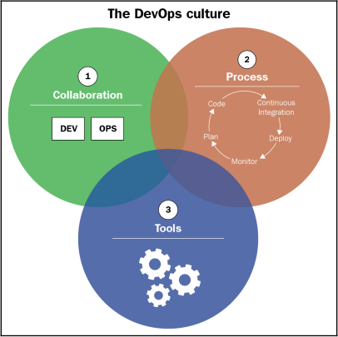
DevOps Trinity
Some of the general principles behind the DevOps are taken from The Agile Manifesto. It is also referred as DevOps Trinity
The DevOps Trinity is Key for Digital Transformation
System administrators are vital part of the creation of DevOps. Automation is a critical component of DevOps.
Developers need to integrate with monitoring tools used by Operations teams to detect performance problems as early as possible and with security tools provided by Ops to protect access to various resources.
Operations s, on the other hand, must automate the creation and updating of the infrastructure and integrate the code into a code manager; this is called Infrastructure as Code,
Ops must also be integrated into application release processes and tools

Slide 72
DevOps Trinity
People and Culture
Processes and Practices
Tools and Technologies –
This means breaking down the traditional silos between teams in the organization and working together towards a common goal.
The goal is to get quality software to the customer as quickly as possible.
Agile and DevOps go hand in hand.
By adopting Agile, Scrum or Kanban, along with automation, organizations can streamline processes in predictable and repeatable ways.
Without the right tools and technologies in place, DevOps is not a sustainable model.
These enable automation, continuous integration, configuration management, testing, packaging, releasing, and monitoring.

Slide 73
DevOps Principles
Customer-Centric Action: The DevOps team must constantly take customer-centric action to invest in products and services.
End-To-End Responsibility: The DevOps team needs to provide performance support until they become end-of-life. This enhances the level of responsibility and the quality of the products engineered.
Continuous Improvement: DevOps culture focuses on continuous improvement to minimize waste, and it continuously speeds up the improvement of products or services offered.
Automate everything: Automation is a vital principle of the DevOps process, and this is not only for software development but also for the entire infrastructure landscape.
Work as one team: In the DevOps culture, the designer, developer, and tester are already defined, and all they need to do is work as one team with complete collaboration.
Monitor and test everything: Monitor and test everything: The DevOps team needs robust monitoring and testing procedures.

Slide 74
Relationship between Agile & DevOps
Both DevOps and agile are modern software development practices aimed at providing a framework to produce a part of a product, a launch, or a release
Agile | DevOps
Agile Development is an umbrella term for several iterative and incremental software development methodologies. | DevOps is about a culture where development and operations collaborate to give maximum throughput and high-end outcomes.
Agile development is one significant part of DevOps and was a significant influence in its creation. | Similar to Agile, there are ways through which DevOps can be implemented such as deep communication and automated deployment.
The most popular agile methodologies include Extreme Programming (XP), Scrum, Crystal, Lean Development, and Feature-Driven Development (FDD).

Slide 75
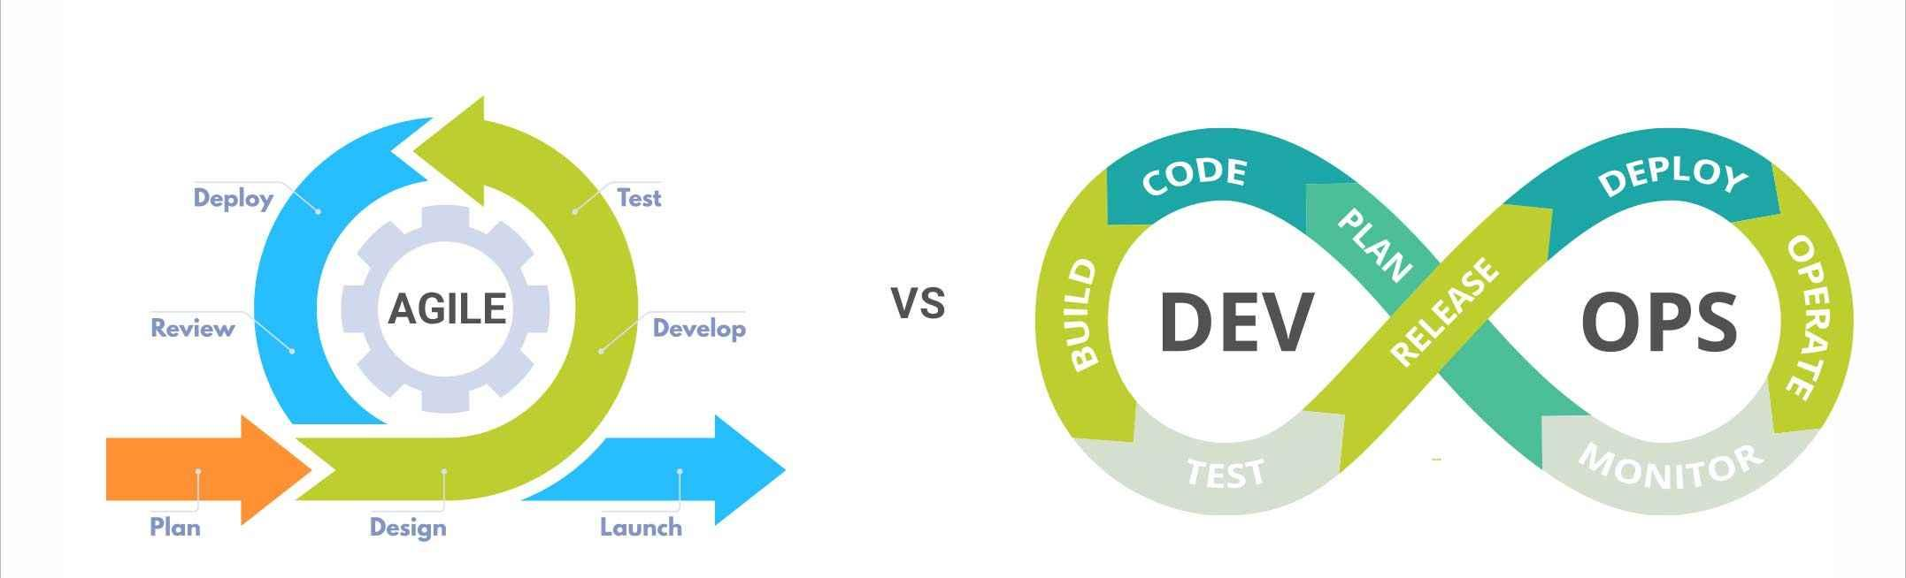
Relationship between Agile & DevOps
Agile is all about software development while DevOps deals with software development and operations. Hence it is clear that DevOps is an extension of agile methodology
There are four basic continuous processes in DevOps in alignment with Agile methodology
Continuous Integration
Continuous Delivery
Continuous Testing
Continuous Monitoring

Slide 76
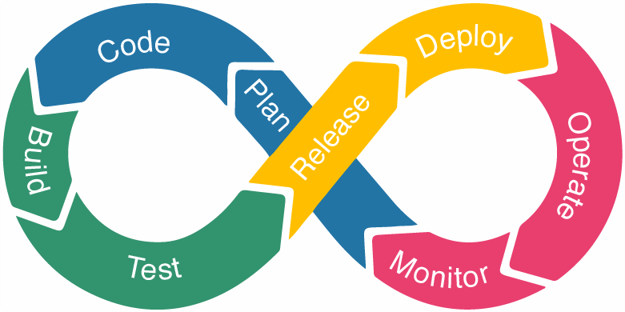
DevOps Lifecycle
The DevOps Lifecycle is a series of development stages that guide everyone as efficiently as possible through the end-to-end process of product development.
It provides a standardized structure to integrate DevOps practices into your delivery pipeline to increase the speed and reliability of the delivery process.
All the stages in the life cycle will continue to iterate throughout the project and go through the lifecycle continuously.
There are seven stages in the DevOps lifecycle as follows
Plan 🡪Code Development 🡪Build (Integration) 🡪Testing 🡪 Release🡪 Deployment 🡪 Operate 🡪Monitoring

Slide 77
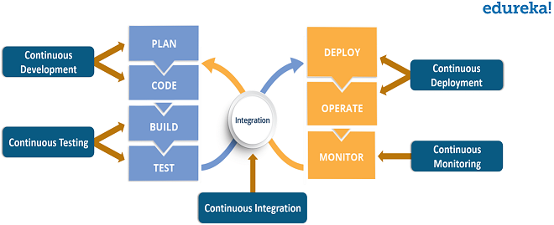
DevOps Lifecycle

Slide 78
DevOps Architecture
DevOps architecture is based on the DevOps Lifecycle i.e. continuous. The components of DevOps architecture are
Reduces the time consumption specifically during the testing and deployment phase.
The teams become more effective with their productivity
Automation
Collaboration
Configuration Management
Integration
Ensures that the application only interacts with the resources concerned with the environment in which it runs.
Continuous integration and testing enable continuous development.

Slide 79
DevOps Architecture
DevOps architecture is based on the DevOps Lifecycle i.e. continuous. The components of DevOps architecture are
1. Automation
2. Collaboration
3. Integration
4. Configuration Management
Automation most effectively reduces the time consumption specifically during the testing and deployment phase.
The productivity increases and releases are made quicker through automation with less issue as tests are executed more rigorously.
his will lead to catching bugs sooner so that it can be fixed more easily.
For continuous delivery, each code change is done through automated tests, through cloud-based services and builds.
This promotes production using automated deploys.
The Development and Operations team collaborates together as DevOps team which improves the cultural model as the teams become more effective with their productivity which strengthens accountability and ownership.
The teams share their responsibilities and work closely in sync which in turn makes the deployment to production faster.
Applications need to be integrated with other components in the environment.
The integration phase is where the existing code is integrated with new functionality and then testing takes place.
Continuous integration and testing enable continuous development.
The frequency in the releases and micro-services lead to significant operational challenges.
This ensures that the application only interacts with the resources concerned with the environment in which it runs.
The configuration files are created where the configuration external to the application is separated from the source code.
The configuration file can be written while deployment or they can be loaded at the run time depending on the environment in which it is running.

Slide 80
DevOps – Infrastructure as Code
Infrastructure as Code (IaC) is an essential DevOps practice, indispensable to a competitively paced software delivery lifecycle.
IaC enables DevOps teams rapidly create and version infrastructure in the same way they version source code and to track these versions so as to avoid inconsistency among IT environments that can lead to serious issues during deployment.
The goal of IaC is to achieve automation and version control, to streamline workflows and get product out faster.
IaC helps to get increased productivity, greater collaboration, improved security, and cost reductions.
Infrastructure as Code (IaC) uses a high-level descriptive coding language to automate the provisioning of IT infrastructure.
This automation eliminates the need for developers to manually provision and manage servers, operating systems, database connections, storage, and other infrastructure elements every time they want to develop, test, or deploy a software application.
Increased Productivity
Cost Reduction
Greater Collaboration
Benefits of IaC
Improved Security
Fewer Bottlenecks

Slide 81
DevOps CI/CD
Continuous Integration (CI)
Continuous Delivery(CD)
Continuous Deployment (CD)
The key DevOps practices is the process of integration and continuous delivery, also called CI/CD or CI/CD pipeline
CI/CD pipeline is one of the best DevOps practices to deliver the code changes frequently and safely.
Continuous Integration and Continuous Delivery are among the most significant practices as they create an active process of integrating and delivering the product to the market.
Small code changes can be made in the software code, making the entire process simpler and more accessible.
CI and CD provide continuous feedback from the customers and the DevOps team, thus increasing the transparency of any problem within the team or outside it.
The overall process ensures the faster release of the product.
The failures can now be detected faster and hence fixed effortlessly and quickly, which increases the speed of release.

Slide 82
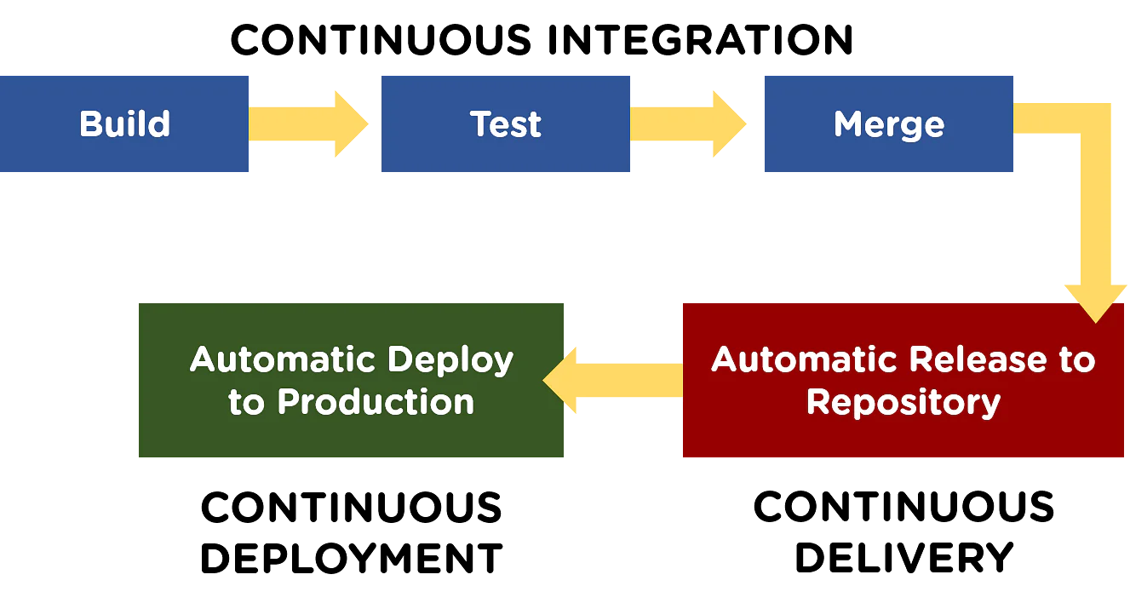
Importance of CI/CD pipeline
Behind the acronyms of CI/CD, there are three practices:
Continuous integration (CI) :
It is a software development practice where members of a team integrate their work frequently.
Each integration is verified by an automated build (including test) to detect integration errors as quickly as possible.
Automated tests make sure that the bugs are captured in the early phases, and fewer bugs reach the production phase.
After the issues are resolved efficiently, it becomes easy to build the release.
Developers are alerted when they break any build, so they have to rebuild and fix the build before moving forth on to the next task.

Slide 83
Importance of CI/CD pipeline
Continuous delivery (CD) :
Continuous Delivery (CD) is a DevOps practice that refers to the building, testing, and delivering improvements to the software code.
The phase is referred to as the extension of the Continuous Integration phase to make sure that new changes can be released to the customers quickly in a substantial manner.
It is a step to deploy the application automatically in one or more non-production environments, which is called staging. This process is called continuous delivery (CD).
The process of deploying software is no more complex, and now the team does not need to spend a lot of time preparing the release anymore.
The releases can be made more frequently, this in turn speeds up the feedback loop with the customers.
The iterations in the case of the process become faster.

Slide 84
Importance of CI/CD pipeline
Continuous deployment(CD)
Continuous deployment is an extension of CD, with a process that automates the entire CI/CD pipeline from the moment the developer commits their code to deployment in production through all of the verification steps.
When the step of Continuous Delivery is extended, it results in the phase of Continuous Deployment. Continuous Deployment (CD) is the final stage in the pipeline that refers to the automatic releasing of any developer changes from the repository to the production.
Continuous Deployment ensures that any change that passes through the stages of production is released to the end-users.
There is absolutely no way other than any failure in the test that may stop the deployment of new changes to the output. This step is a great way to speed up the feedback loop with customers and is free from human intervention.
There is no need to stop the development for releases anymore, as the entire deployment process is now automated.

Slide 85
DevOps Toolchain
A DevOps toolchain includes the tools and technology that enable development and operations teams to collaborate across the entire software lifecycle. It tackles key DevOps fundamentals including continuous integration, continuous delivery, automation, and collaboration.
The DevOps toolchain helps organizations maintain and regulate a solid and steady software development pipeline.
Toolchains assist team members in simplifying and completing more intricate and complicated development activities.
In general, the tools forming a toolchain are executed consecutively so the output or resulting environment state of each tool becomes the input or starting environment for the next one, but the term is also used when referring to a set of related tools that are not necessarily executed consecutively.
Plan
Create
Verify
Packaging
Release
Configure
Monitor
Version Control
Stags of DevOps Toolchain

Slide 86
DevOps Toolchain
DevOps toolchain is used to implement CI/CD pipeline effectively.
As DevOps is a set of practices that emphasizes the collaboration and communication of both software developers and other information technology (IT) professionals, while automating the process of software delivery and infrastructure changes, its implementation can include the definition of the series of tools used at various stages of the lifecycle;
Because DevOps is a cultural shift and collaboration between development and operations, there is no one product that can be considered a single DevOps tool.
Instead a collection of tools, potentially from a variety of vendors, are used in one or more stages of the lifecycle.
Generally, the DevOps toolchain encompasses four categories:
Build automation and source code management, such as Git and GitHub, Bitbucket or similar cloud services;
Continuous integration software, such as Jenkins or Travis CI;
Application deployment and configuration management tools, including Ansible, Chef and Puppet; and
Infrastructure deployment software, such as HashiCorp Terraform or Amazon Web Services (AWS) CloudFormation.

Slide 87
DevOps Toolchain
There are various DevOps toolchain options to refine IT automation
All-in-one DevOps toolchain
DIY or buy DevOps toolchain
Organizations that most aggressively adopt cloud services are in luck because the large public
Cloud providers offer various services at each stage of the toolchain with APIs, sample code and reference designs detailing how to integrate them.
Cloud providers grew in for rapid application development and deployment.
e.g. Microsoft Azure CI/CD tooling, AWS CodeDeploy Azure Automation Desired State Configuration, Google Cloud Deployment Manager
Building DevOps toolchains out of local servers and software typically requires more do-it-yourself integration work, particularly with popular open source tools.
Integration details are highly dependent on the tools.
For example, a typical developer chain of Git for source code and build management, Jenkins for CI, and Chef for configuration management and deployment can be stitched together using ready-made modules due to each tool's built-in extensibility and APIs.

Slide 88
DevOps Tool(s)
DevOps Tool is an application that helps automate the software development process. It mainly focuses on communication and collaboration between product management, software development, and operations professionals.
DevOps tool also enables teams to automate most of the software development processes like build, conflict management, dependency management, deployment, etc. and helps reduce manual efforts.
While DevOps is a culture, the right stack of tools makes it possible to implement DevOps successfully.
DevOps approach emphasis is on the automation of software development processes like build, test, incident detection and response, release, and others to yield a faster time-to-market, high-quality products, and reduced failures and rollbacks of software/software features.
Configuration Management
Analytics
Version Control Management
DevOps Tools
Monitoring and Logging
Code Review
Continuous Delivery
Continuous Integration

Slide 89
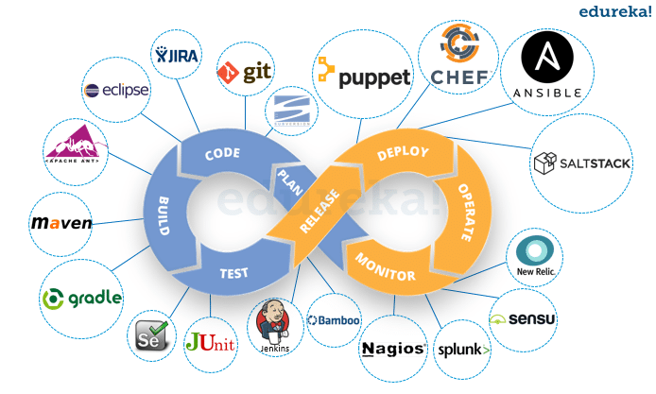
DevOps Tools

Slide 90
DevOps Tools
Configuration Management(CM)
It is based on making a stable, reliable and mobile environment for code deployment.
With the right approach, Configuration Management allows transferring projects quickly.
The environment is packed in a Docker container and can be deployed in any other place.
This process is provisioned by Ansible, Chef, Puppet, Salt and other instruments.
Version Control Management:
The most popular instrument for version control is Git.
This is a distributed version control system, an open-source tool that allows you to store all the changes in software and go to the previous version if needed.
This is an invaluable tool for development and DevOps because you can control every change in the development process.
The most popular Git instruments are Github and Gitlab.

Slide 91
DevOps Tools
Code Review:
Github, Gitlab is useful for this point too.
Code review is the process of checking the code, new functionality and comparing it with previous versions.
Continuous Integration (CI):
CI is perceived as the basic DevOps principle.
Continuous Integration allows to test code automatically and adds new features to the main code as fast as possible.
DevOps engineer configures the system in the way that the developer writes code and it’s tested automatically and after successful testing can be used in the main software
The most popular instruments for CI are Gitlab CI, CircleCI and Jenkins.

Slide 92
DevOps Tools
Continuous Delivery (CD):
CD means deliver the software to end-users as fast, as possible.
Before the DevOps methodology introduction, new versions of the software were delivered very slowly and rarely.
Every small change needed a lot of time for implementation.
CI/CD pipeline automates this process and allows to deliver new features quickly.
The same tools are used for CD implementation as for CI.
Monitoring and Logging:
This is an important point in the DevOps lifecycle to monitor the infrastructure performance and remove bottlenecks for uninterrupted work and updates.
It’s quite difficult to do it manually, so there are some tools for logging and monitoring in the DevOps.
Some of the popular tools for monitoring and logging include Amazon Cloud Watch, Carbon, Prometheus, Grafana, Icinga, Google StackDriver, Kibana, ElasticSearch, Logstash, and others.

Slide 93
DevOps Tools
Analytics:
DevOps engineers need to analyze the information collected from previous steps.
It is required to understand patterns and eliminate errors.
Some of the analytics tools are Splunk and SumoLogic.
Messaging:
Messaging allows us to store all the changes and deliver the information between system components.
It is accomplished by RabbitMQ and Amazon SQS.

Slide 94
DevOps Summary
DevOps represents a change in IT culture, focusing on rapid IT service delivery through the adoption of agile, lean practices in the context of a system-oriented approach.
DevOps emphasizes people (and culture), and it seeks to improve collaboration between operations and development teams. (Source: Gartner IT Glossary 2015)
DevOps is a set of practices that combines software development (Dev) and IT operations (Ops).
It aims to shorten the systems development life cycle and provide continuous delivery with high software quality.
DevOps is complementary with Agile software development; several DevOps aspects came from the Agile way of working. DevOps is a combination of specific practices, culture change, and tools.
A DevOps toolchain is a set or combination of tools that aid in the delivery, development, and management of software applications throughout the systems development life cycle, as coordinated by an organization that uses DevOps practices.

Slide 95
Software Engineering in various applications

Slide 96
Software engineering in various applications
Role of Software Engineering in
Iot applications
Data science applications
Cloud computing
Cyber security applications

Slide 97
BOOKS
Books:
The Art of Agile Development James Shore, Shane Warden "O'Reilly Media, Inc." 3rd Edition, 2010

